Slide 1
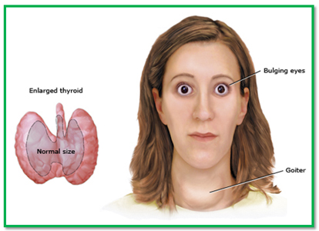
Thyroid Disorders

Slide 2
INTRODUCTION
Thyroid rule:
In a child, critical for normal growth and development.
In an adult, maintain metabolic stability.
Thyroid disorders result in alterations in metabolic stability. Hyperthyroidism and hypothyroidism are the clinical and biochemical syndromes resulting from increased and decreased thyroid hormone production.
The common type (hereditary):
Thyrotoxicosis is most commonly caused by Graves’ disease, autoimmune disorder {thyroid-stimulating antibody (TSAb) elicits the same biologic response as thyroid-stimulating hormone (TSH)}.
Hypothyroidism is most often due to an autoimmune disorder known as Hashimoto’s thyroiditis.

Slide 3
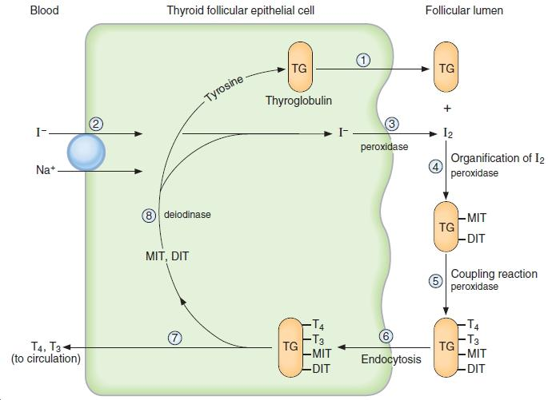
Thyroid hormone synthesis
lithium block iodide transport into the thyroid.
Lithium and iodide(large dose) inhibit thyroid hormone secretion

Slide 4
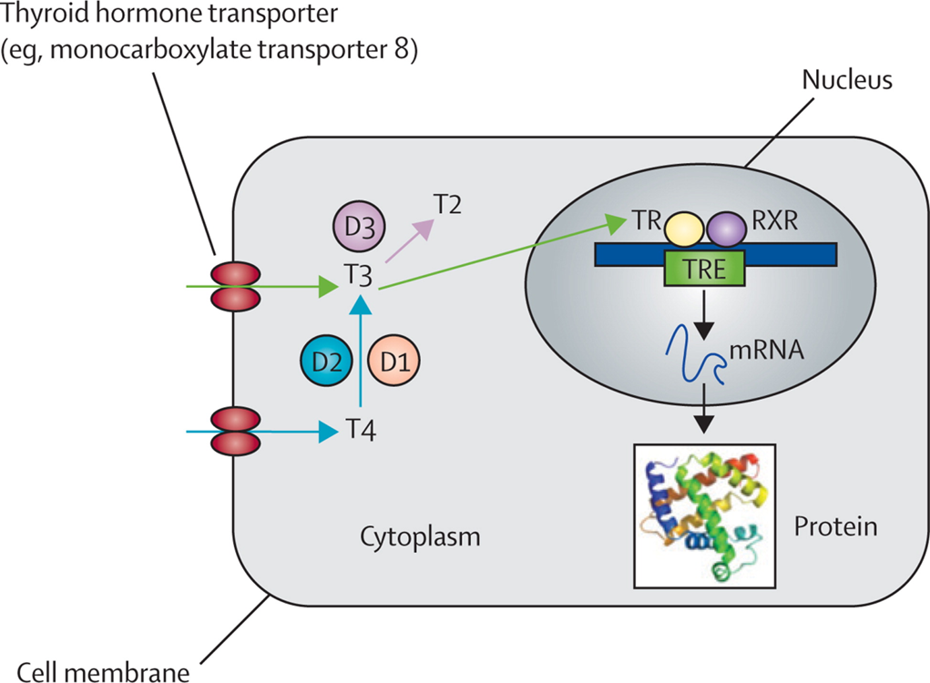
INTRODUCTION
T4 and T3 are transported in the bloodstream by three proteins: thyroid-binding globulin (TBG), thyroid-binding prealbumin, and albumin. It is estimated that 99.96% of circulating T4 and 99.5% of T3 are bound to these proteins.
Only the unbound (free) thyroid hormone diffuses into the cell, elicit a biologic effect, and regulate (TSH) secretion from the pituitary.
The majority of T3 is from the breakdown of T4 by the enzyme 5'-monodeiodinase found in peripheral tissues.
Three different isoforms of monodeiodinase enzymes are present in the body (D1, D2, D3)

Slide 5
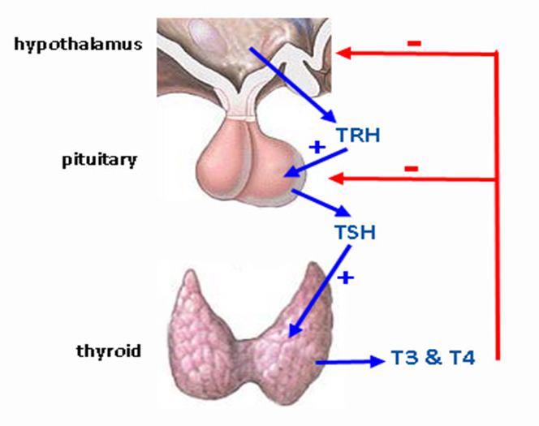
Comparing T4 and T3
T4 is secreted solely from the thyroid gland; the majority of T3 is formed from the breakdown of T4 catalyzed by the enzyme 5'-monodeiodinase found in peripheral tissues.
the binding affinity of nuclear thyroid hormone receptors (TRs) is 10 to 15 times higher for T3 than for T4.
T3 is about five times more active than T4.
Thyroid hormone production is regulated by TSH secreted by the anterior pituitary, which in turn is under negative feedback control by the circulating level of free thyroid hormone and the positive influence of hypothalamic thyrotropin-releasing hormone (TRH).

Slide 6
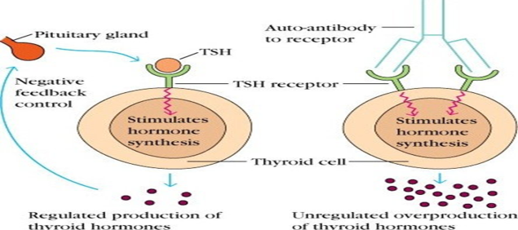
Pathophysiology
TSH-secreting pituitary tumors release biologically active hormone that is unresponsive to normal feedback control. The tumors may co-secrete prolactin or growth hormone showing amenorrhea, galactorrhea, or signs of acromegaly.
TSH-Induced Hyperthyroidism: Criteria for the diagnosis of TSH-induced hyperthyroidism include, (a) elevated free thyroid hormone levels, (b) elevated or inappropriately “normal” serum immunoreactive TSH concentrations and(c) diffuse thyroid gland enlargement.
In Graves’ disease, hyperthyroidism results from the action of thyroid-stimulating antibodies (TSAb) directed against the thyrotropin receptor on the surface of the
thyroid cell in the same manner as TSH.

Slide 7
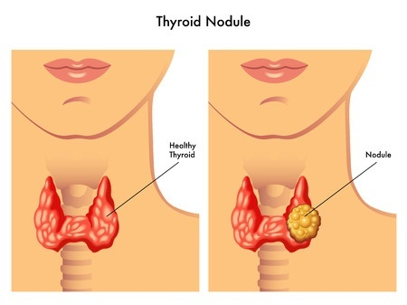
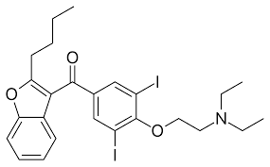
Pathophysiology
Special types of hyperthyroidism:
An autonomous thyroid nodule is a discrete thyroid mass whose function is independent of pituitary and TSH control.
Painful subacute thyroiditis often develops after a viral syndrome.
Thyrotoxicosis factitia was described as “all causes of hyperthyroidism due to ingestion of thyroid hormone
Drug induced: Amiodarone may induce thyrotoxicosis (2% to 3% of patients). It interferes with type I 5'-deiodinase, leading to reduced conversion of T4 to T3, and iodide release from the drug may contribute to iodine excess.

Slide 8
 | Hyperthyroidism CLINICAL PRESENTATION
General | nervousness, anxiety, Fatigue, proximal muscle weakness, difficult sleeping
Neck | Goiter
heart | palpitations, systolic ejection murmur
skin | warm, smooth, moist skin, onycholysis
Body temp | heat intolerance, sweating
weight | loss of weight with increased appetite
GIT | increased frequency of bowel movements, N and D
eye | lid lag, exophthalmos (graves only)
hair | unusually fine hair with hair loss
neuron | hyperactive deep tendon reflexes, hand tremor
hormonal | scanty or irregular menses, Gynecomastia in men
A cardinal sign is loss of weight with an increased appetite.

Slide 9
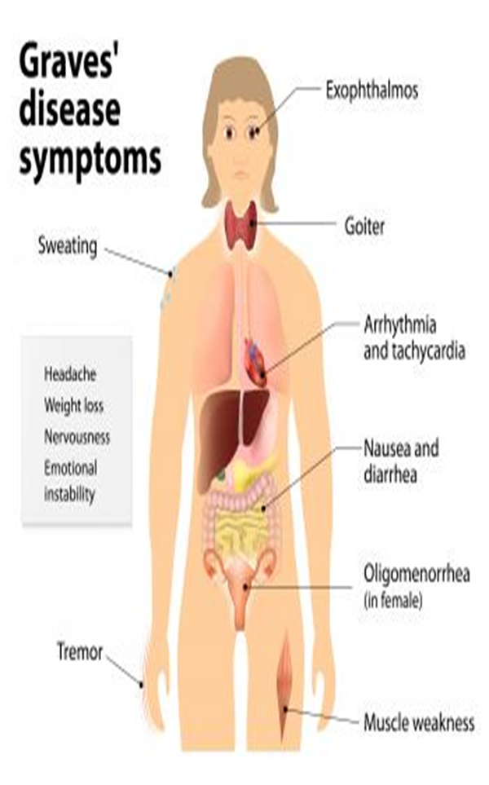

Slide 10
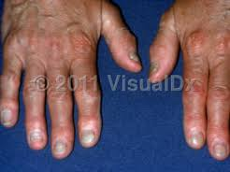
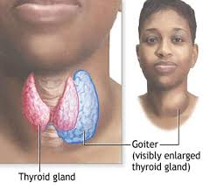
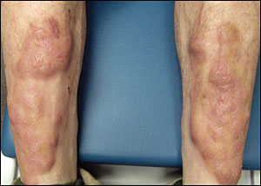
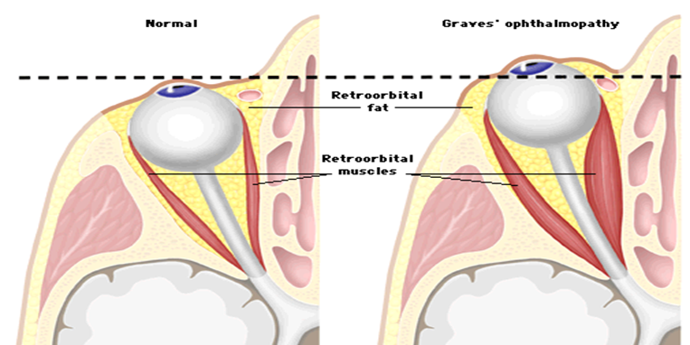
CLINICAL PRESENTATION
Graves’ disease is manifested by hyperthyroidism, diffuse thyroid enlargement (two to three times the normal size), and the extrathyroidal findings of exophthalmos, and, less commonly, pretibial myxedema, and thyroid acropachy.
An important clinical feature of Graves’ disease is the occurrence of spontaneous remissions (uncommon). The abnormalities in TSAb production may decrease or disappear over time in many patients.
Notes:
waxy, discolored induration of the skin, acropachy: soft-tissue swelling of the hands and clubbing of the fingers. Facial appearance in Graves’ disease; lid retraction, periorbital edema, and proptosis are marked.

Slide 11
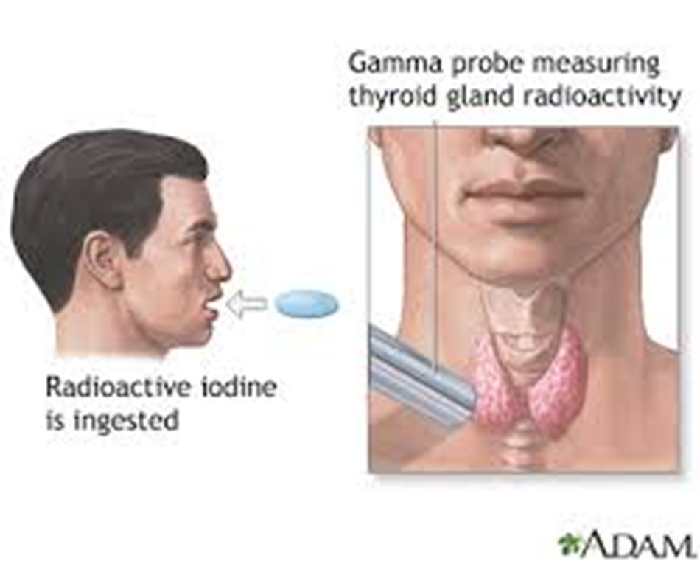
DIAGNOSIS
For differential diagnosis: An elevated 24-hour radioactive iodine uptake (RAIU) indicates true hyperthyroidism: the patient’s thyroid gland is overproducing T4, T3, or both (normal RAIU 10% to 30%). Conversely, a low RAIU indicates that the excess thyroid hormone is not a consequence of thyroid gland hyperfunction but is likely caused by thyroiditis or hormone ingestion.

Slide 12
DIAGNOSIS
TSH-induced hyperthyroidism is diagnosed by evidence of peripheral hypermetabolism, diffuse thyroid gland enlargement, elevated free thyroid hormone levels and elevated serum TSH concentrations.
TSH-secreting pituitary adenomas are diagnosed by demonstrating lack of TSH response to thyrotropin-releasing hormone stimulation and radiologic imaging.

Slide 13
DESIRED OUTCOME
normalize the production of thyroid hormone
Relieve symptoms
minimize long-term consequences
Prevent precipitating factors
Treatment guidelines:
Antithyroid, RAI or surgery (according to the case).
Adjunctive therapy with β-blockers controls the adrenergic symptoms of thyrotoxicosis but does not correct the underlying disorder; iodine may also be used adjunctively in preparation for surgery and acutely for thyroid storm.

Slide 14
Treatment guidelines:
Treatment | Indication (selection)
Methimazole (PTU only 2nd line) | -First line for children, adolescent, pregnancy -Initial therapy in severe cases or preoperative preparation -before RAI, in elderly and with cardiac symptoms of graves
RAI (¹³¹I) | -Best treatment for graves disease, and toxic nodule -Anthithyroid Failure
surgery | -Pregnancy if antithyroid is avoided -Refuse RAI -large gland (>80 g), severe ophthalmopathy -Potential complications (laryngeal nerve damage)

Slide 15
Nonpharmacologic Therapy (surgery)
Before
propylthiouracil (PTU) or methimazole (MMI) is usually given until the patient is biochemically euthyroid (usually 6 to 8 weeks
followed by the addition of iodides (500 mg/day) for 10 to 14 days before surgery to decrease the vascularity of the gland
During
Surgery
After
propranolol 7 to 10 days after surgery to maintain a pulse rate less than 90 beats/min.
Propranolol has been used for several weeks preoperatively to maintain a pulse rate less than 90 beats/min

Slide 16
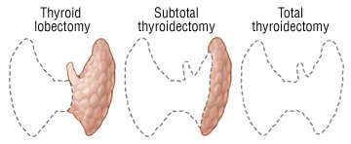
Nonpharmacologic Therapy
Complications of surgery:
hypothyroidism (up to about 49%) requires periodic follow-up
hyperthyroidism (0.6% to 18%)
hypoparathyroidism (up to 4%)
vocal cord abnormalities (up to 5%).

Slide 17
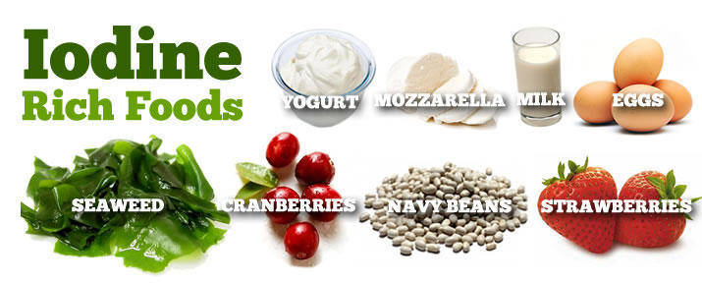
Nonpharmacologic Therapy
Smoking
Hyperthyroidism: Smoking: worsen the overactive graves disease (specially eye problem and mental) twice more sever symptoms.
Hypothyroidism:Thiocyanate, a major component of smoke, derived from hydrogen cyanide, leads to increased excretion of iodine, inhibits iodine uptake by the thyroid, competes with iodide in the organification process and inhibits thyroid hormone synthesis.
Diet: diet alone can manage thyroid disorder.
Hypothyroidism: avoid eating fatty food, recommend iodine containing diet (like ) specially in iodine deficient areas.

Slide 18
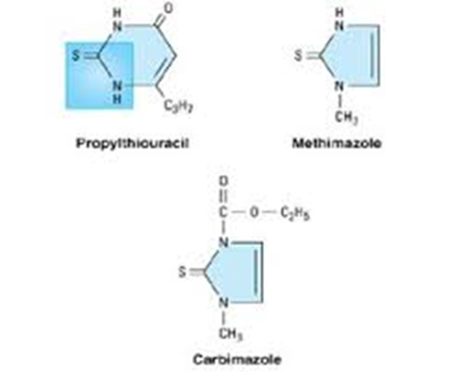
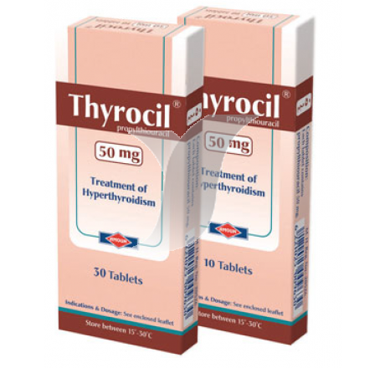
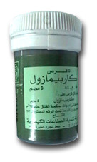
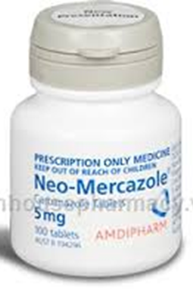
Pharmacological therapy
iodide
thionamide
thionamide
iodide

Slide 19
Thioureas (Thionamides)
 | PTU (propul thiouracil) | Methimazole (MMI)
Mech | -inhibiting the peroxidase enzyme system of the thyroid gland, -inhibit organification, -inhibit coupling -immunosuppresive (week), inhibits the peripheral conversion of T4 to T3 in dose dependant manner | Same but no inhibtion of peripheral convesrion
choice | Second line | First line
Distrib | Bound to plasma protin No placenta or milk passing | not protein bound. crosses the placenta,in breast milk.
Preg. | After the first trimester | The first trimester
dose | 300 to 600 mg daily (usually in three or four divided doses) | 30 to 60 mg daily given in three divided doses
SE | Minor: Rash, leukopenia (transient) Major: agranulocytosis (with fever, malaise, gingivitis, oropharyngeal infection, and a granulocyte < 250/ mm3 ),aplastic anemia, GI intolerance, hepatotoxicity, hypoprothrombinemia, cross-sensitivity. | Same but less hepatotoxicity with teratogenicity (avoid in the first trimester only )

Slide 20
Thioureas (Thionamides)
Improvement occur within 4 to 8 weeks (till end of the intrathyroidal pool of thyroid hormone), at which time a tapering regimen to maintenance doses can be started. Dosage changes should be made on a monthly basis . Typical daily maintenance doses are PTU 50 to 300 mg and MMI 5 to 30 mg.
The maximal blocking doses of PTU and MMI are 1,200 and 120 mg daily, respectively. Maximal response is obtained in 4 to 6 months.
Antithyroid drug therapy should continue for 12 to 24 months to induce a long-term remission.
Patients should be monitored every 6 to 12 months after remission. If a relapse occurs, alternate therapy with RAI is recommended.

Slide 21
Iodides
Mechanism:
blocks thyroid hormone release,
inhibits thyroid hormone biosynthesis by interfering with intrathyroidal iodide use,
decreases the size and vascularity of the gland.
Symptom improvement occurs within 2 to 7 days of initiating therapy, and serum T4 and T3 concentrations may be reduced for a few weeks. The normal and hyperfunctioning thyroid soon escapes from this inhibitory effect within 1 to 2 weeks by decreasing the active transfer of iodide into the gland.
Indication:
adjunctive therapy to prepare for surgery
to acutely inhibit thyroid hormone release and quickly attain the euthyroid state in severely thyrotoxic patients with cardiac decompensation,
inhibit thyroid hormone release after RAI therapy (not before RAI).

Slide 22
Iodides
Potassium iodide is available as a saturated solution (SSKI, 38 mg iodide per drop) or as Lugol’s solution, containing 6.3 mg of iodide per drop.
The typical starting dose of SSKI is 3 to 10 drops daily (120 to 400 mg) in water or juice.
Adverse effects:
Hypersensitivity reactions (skin rashes, drug fever, rhinitis, conjunctivitis);
“iodism” (metallic taste, burning mouth and throat, sore teeth and gums, symptoms of a head cold, and sometimes stomach upset and diarrhea)
large doses of iodine may exacerbate hyperthyroidism or indeed precipitate hyperthyroidism iodine-deficient areas.

Slide 23
Adrenergic Blockers (symptomatic tretament)
Many of the manifestations of hyperthyroidism are mediated by β-adrenergic receptors, β-Blockers have been used widely to ameliorate thyrotoxic symptoms such as palpitations, anxiety, tremor, and heat intolerance.
They have no effect on peripheral thyrotoxicosis and protein metabolism and do not reduce TSAb or prevent thyroid storm.
Propranolol and nadolol partially block the conversion of T4 to T3, but this contribution to the overall therapeutic effect is small.
β-Blockers are usually used as adjunctive therapy with antithyroid drugs, RAI, or iodides when treating Graves’ disease; in preparation for surgery; or in thyroid storm.

Slide 24
Adrenergic Blockers
Propranolol initial dose of 20 to 40 mg four times daily is effective for most patients (obtain HR less than 90 beats/min). Younger or more severely toxic patients may require as much as 240 to 480 mg/day.
β-Blockers are contraindicated in patients with decompensated heart failure, sinus bradycardia
Side effects include bradycardia, and hematologic disturbances, nausea, vomiting, anxiety, insomnia, lightheadedness.
Centrally acting sympatholytics (e.g., clonidine) and calcium channel antagonists (e.g., diltiazem) may be useful for symptom control when contraindications to β-blockade exist.

Slide 25
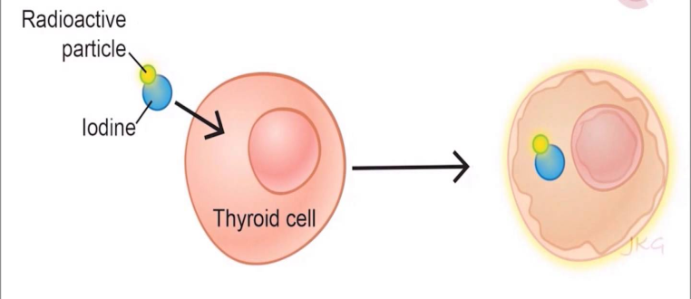
Radioactive Iodine
Sodium iodide 131 is an oral liquid that concentrates in the thyroid and initially disrupts hormone synthesis by incorporating into thyroid hormones and thyroglobulin. Over a period of weeks, follicles that have taken up RAI and surrounding follicles develop evidence of cellular necrosis and fibrosis of the interstitial tissue.
RAI is administered as a colorless and tasteless liquid that is well absorbed and concentrates in the thyroid.
RAI is the agent of choice for Graves’ disease, toxic autonomous nodules. Pregnancy is an absolute contraindication to the use of RAI.

Slide 26
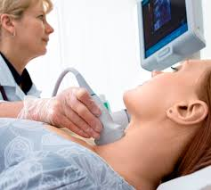
Radioactive Iodine
The goal of therapy is to destroy overactive thyroid cells, as a single dose of 4,000 to 8,000 rad. It is advisable that a second dose of RAI be given 6 months after the first RAI treatment if the patient remains hyperthyroid.
Side effects:
Hypothyroidism commonly occurs months to years after RAI.
The acute, short-term side effects include mild thyroidal tenderness and dysphagia.
Long-term follow-up has not revealed an increased risk for development of thyroid carcinoma, leukemia.

Slide 27
RAI
β-Blockers are the primary adjunctive therapy to RAI, since they may be given anytime without compromising RAI therapy.
thionamides prior to RAI ablation because thyroid hormone levels will transiently increase after RAI treatment due to release of preformed thyroid hormone.
iodides should be given 3 to 7 days after RAI to prevent interference with the uptake of RAI in the thyroid gland.

Slide 28
EVALUATION OF THERAPEUTIC OUTCOMES
After therapy (thionamides, RAI, or surgery) for hyperthyroidism, evaluate on a monthly basis until they reach a euthyroid condition.
Clinical signs of continuing thyrotoxicosis or the development of hypothyroidism should be noted.
Once T4 replacement is initiated (if hypothyroidism occur), the goal is to maintain both the free T4 level and the TSH concentration in the normal range. Once a stable dose of T4 is identified, the patient may be followed every 6 to 12 months.

Slide 29
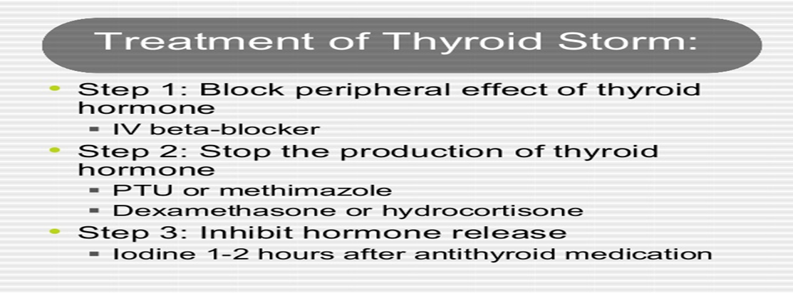
Thyroid storm
It is a life-threatening medical emergency characterized by severe thyrotoxicosis, high fever (often greater than 39.4°C), tachycardia, tachypnea, dehydration, delirium, coma, nausea, vomiting, and diarrhea.
Precipitating factors include infection, trauma, withdrawal from antithyroid drugs.

Slide 30
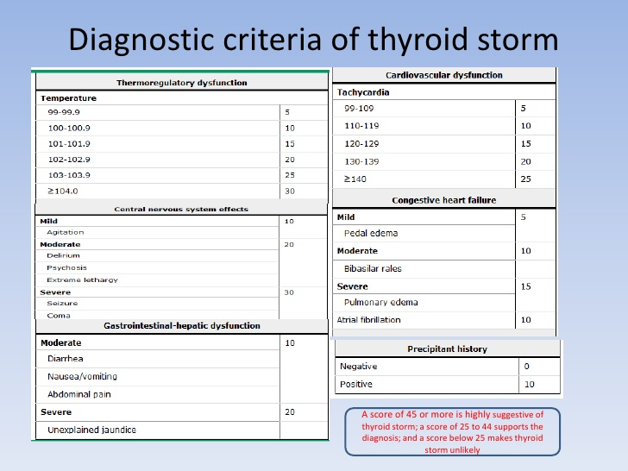

Slide 31
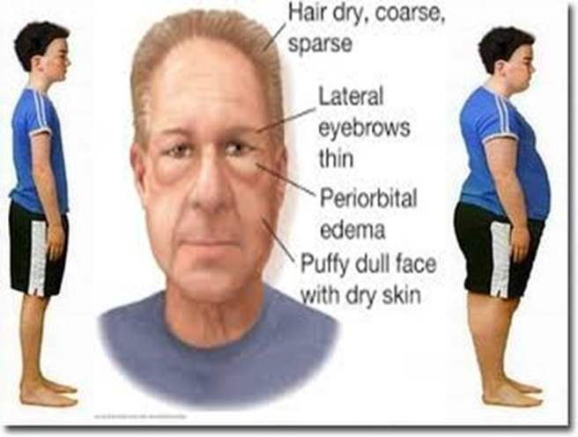
Hypothyroidism

Slide 32
PATHOPHYSIOLOGY
Uncorrected thyroid hormone deficiency during fetal and neonatal development results in mental retardation and/or cretinism.
In adult, There is slowing of physical and mental activity, as well as of cardiovascular, GI, and neuromuscular function.
Mainly, thyroid gland failure (primary hypothyroidism) The causes include chronic autoimmune thyroiditis (Hashimoto’s disease), iatrogenic hypothyroidism (after surgery or radiation), iodine deficiency.
Pituitary failure (secondary hypothyroidism) is an uncommon cause resulting from pituitary tumors, surgical therapy, external pituitary radiation.

Slide 33
CLINICAL PRESENTATION
 | Hypothyroidism CLINICAL PRESENTATION
General | lethargy, fatigue, muscle cramps, myalgia, stiffness, and loss of ambition or energy
Neck | Puffy face, slowed or hoarse speech, goiter
heart | bradycardia
skin | dry coarse skin
Body temp | cold intolerance
weight | Sudden Weight gain with poor appetite
GIT | constipation
eye | Periorbital puffiness
hair | Dry coarse hair with hair loss
neuron | slow relaxation of deep tendon reflexes, carpal tunnel syndrome
hormonal | Abnormal heavy menses, galactorrhea and decreased libido

Slide 34
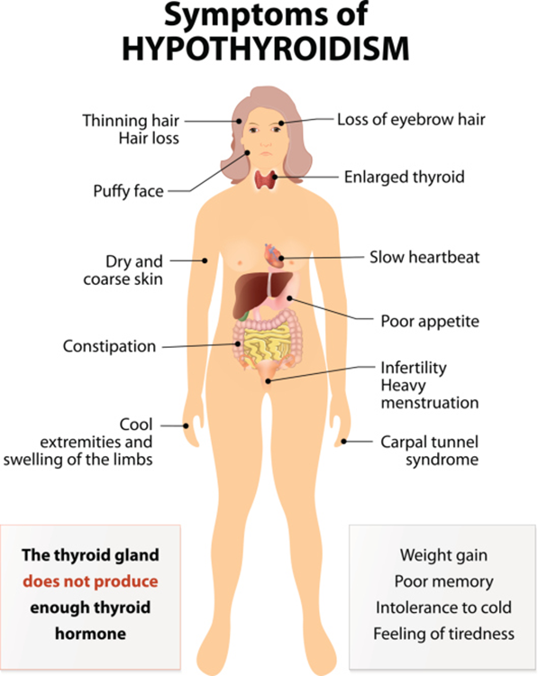

Slide 35
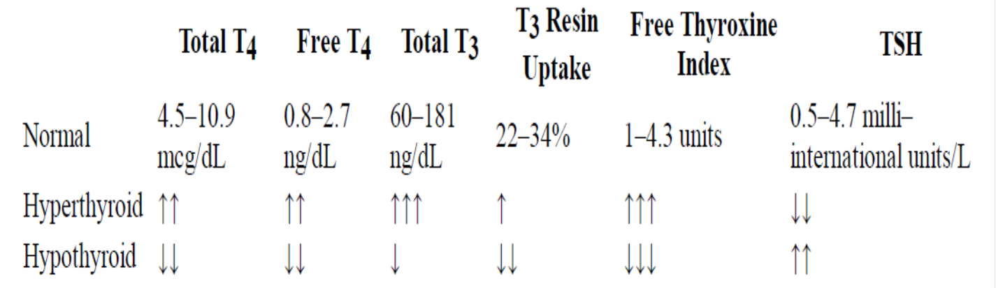
DIAGNOSIS
Antithyroid peroxidase antibodies and antithyroglobulin antibodies are likely to be elevated.
The RAIU is not a useful test in the evaluation of hypothyroidism.
Pituitary failure (secondary hypothyroidism) should be suspected in a patient with decreased levels of T4 and inappropriately normal or low TSH levels.

Slide 36
DESIRED OUTCOME
normalize thyroid hormone concentrations in tissue
provide symptomatic relief
prevent neurologic deficits in newborns and children.
Prevent progression of disorder to Myxedema coma
Treatment guidelines:
Levothyroxin (synthetic T4) is the DOC.
Thyroid, USP (or desiccated thyroid).
Thyroglobulin is a purified hog-gland extract (prohibited).
Liothyronine (synthetic T3).
Liotrix (synthetic T4:T3 in a 4:1 ratio).

Slide 37
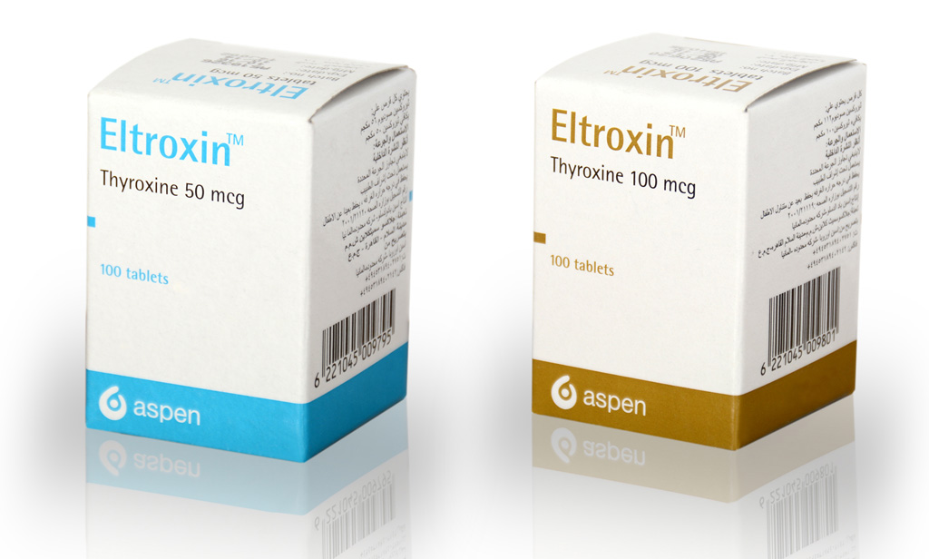
TREATMENT OF HYPOTHYROIDISM
Levothyroxine (Synthetic L-thyroxine, T4) is the drug of choice for thyroid hormone replacement because:
it is chemically stable
relatively inexpensive
free of antigenicity
has uniform potency
Levothyroxine results in a pool of thyroid hormone that is readily and consistently converted to T3.
NB: however, any of the commercially available thyroid preparations can be used. Once a particular product is selected, therapeutic interchange is discouraged.

Slide 38
TREATMENT OF HYPOTHYROIDISM
started on 50 mcg daily of levothyroxine and increased to 100 mcg daily after 1 month for older people without cardiac symptoms. for older patients or those with known cardiac disease is 25 mcg/day titrated upward in increments of 25 mcg at monthly intervals to prevent stress on the cardiovascular system.
The average maintenance dose for most adults is about 125 mcg/day.
Pregnancy: Levothyroxine is the drug of choice for pregnant women, and the objective of the treatment is to decrease TSH to 1 mIU/L.
Drug interaction:
Cholestyramine, calcium carbonate, sucralfate, aluminum hydroxide, ferrous sulfate, may impair the absorption of levothyroxine.
Drugs that increase T4 clearance include rifampin, carbamazepine, and possibly phenytoin.

Slide 39
TREATMENT OF HYPOTHYROIDISM
Thyroid, USP (or desiccated thyroid) is derived from hog, beef, or sheep thyroid gland. It may be antigenic in allergic or sensitive patients. Inexpensive generic brands may not be bioequivalent.
Liothyronine (synthetic T3) has uniform potency but has a higher incidence of cardiac adverse effects, higher cost, and difficulty in monitoring with conventional laboratory tests.
Liotrix (synthetic T4:T3 in a 4:1 ratio) is chemically stable, pure, and has a predictable potency but is expensive. It lacks therapeutic rationale because about 35% of T4 is converted to T3 peripherally.
Side effects:
Excessive doses of thyroid hormone cause hyperthyroidism, heart failure, and myocardial infarction. Excess exogenous thyroid hormone may reduce bone density and increase the risk of fracture.

Slide 40
EVALUATION OF THERAPEUTIC OUTCOMES
Serum TSH concentration is the most sensitive and specific monitoring parameter for adjustment of levothyroxine dose. Concentrations begin to fall within hours and are usually normalized within 2 to 6 weeks.
TSH and T4 concentrations should both be checked every 6 weeks until a euthyroid state is achieved. An elevated TSH level indicates insufficient replacement.
In secondary hypothyroidism, alleviation of the clinical syndrome and restoration of serum T4 to the normal range are the only criteria available for estimating the appropriate replacement dose of levothyroxine.
Given that the half-life of T4 is 7 days, the appropriate monitoring interval is 4 weeks for any dose modification.

Slide 41
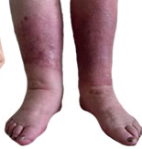
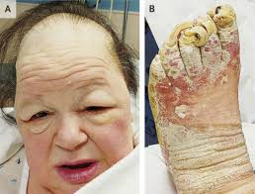
Myxedema coma
A rare consequence of decompensated hypothyroidism with manifested by myxedema, hypothermia, advanced stages of hypothyroid symptoms, and delirium then coma. Untreated disease is associated with a high mortality rate.
There is impaired conversion of T4 to T3.
Precipiatating factors include:
Infection (pneumonia, sepsis), not taking medication, sever cold environment, myocardial infarction, heamorrhage)

Slide 42
TREATMENT OF MYXEDEMA COMA
1-IV bolus levothyroxine, 300 to 500 mcg, Initial treatment with IV liothyronine may be used.
2-Glucocorticoid therapy with IV hydrocortisone 100 mg every 8 hours. Consciousness, lowered TSH concentrations, and normal vital signs are expected within 24 hours.
3-Maintenance levothyroxine doses are typically 75 to 100 mcg IV until the patient stabilizes and oral therapy is begun.
4-Supportive therapy must be instituted to maintain adequate ventilation, blood pressure, and body temperature. Underlying disorders such as sepsis and myocardial infarction must be diagnosed and treated.

